Slide 1
Test detail
Xing Xiang

Slide 2
How this program work
connect.cpp regard the License Plate number input. It hears from the simulator (udp socket).
As soon as the License Plate number is given by the simulator, the program will check out the customer information from database, such as arrival time, estimate depature time and send a confirmation email to the email address.

Slide 3
How this program work
After that , the payment will be calculated based on our charging policy and send a confirmation email to the user.
At last, the information for this vehicle will be deleted from database and stored in a file as historylog.

Slide 4
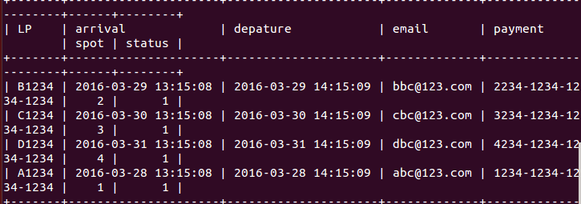
database
the database is in consistant with arrival database.
Here is the database which I created in advance, which include 4 customer info.
here is the data to be operated later

Slide 5
compiling details
Here I simulate the program with an license plate number exist in the datbase
the program caculated the corresponding fee and print out the details for this reservation

Slide 6
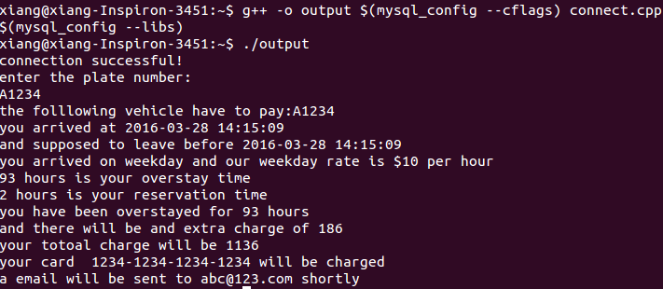
compiling details
the details will be stored in the histoy.txt file and deleted from the database
license plate number
stay time detail
rate detail
charge amount
payment method
email address

Slide 7
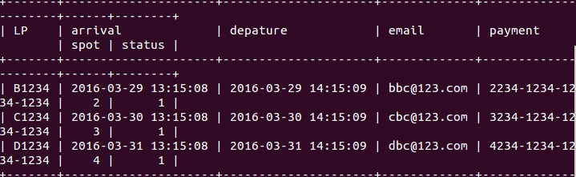
Here is the database after simulation, the previous data has been already removed
here is the data to be operated
data removed

Slide 8
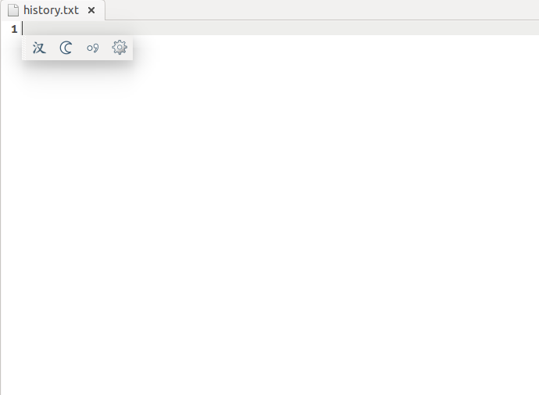
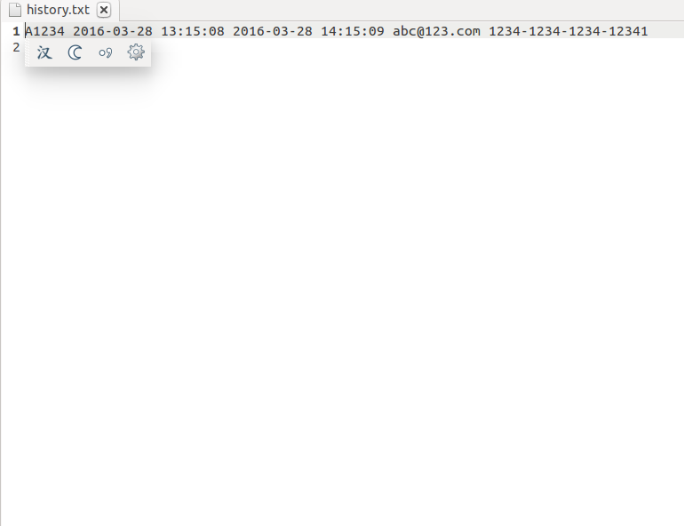
And the data will be added to historylog
vacant
data added

Slide 9
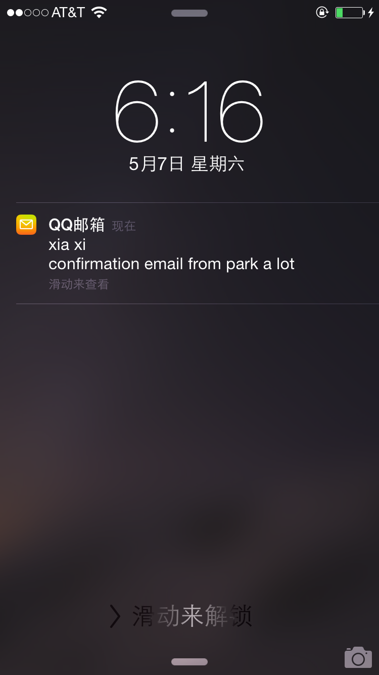
Here I used my email address and the confrimation email was sent

